Slide 1


A Final Year Project Work Mid Defence
On
MNIST based Handwritten Digit Recognition using Deep Learning
Presented By:
Biswas Poudyal(10526/073)
Krishna Khanal(10691/073)
Sameer Kattel(10713/073)
Subina Lama(10720/073)
May, 2020
Notes:
1

Slide 2
Presentation Outline
Introduction
Objectives
System Analysis
System Design
Visualization
Output and Analysis
Conclusion and Further Work
2

Slide 3
Introduction
Handwritten Digit Recognition is an approach of enabling computers to recognize human written digits through a complicated process of learning called Machine Learning.
The project intends to implement a Feedforward Neural Network model from scratch, that will be able to recognize the handwritten digits with high accuracy.
3

Slide 4
Objectives
To design a Multi-Layer FFNN Model that recognizes Handwritten digits (one at a time) with high accuracy.
To properly analyze and optimize the designed model using different model improvement techniques and optimization algorithms.
To implement the components of the project from scratch.
4

Slide 5
System Analysis
Functional Requirements
The model should be able to classify any new image of a handwritten digit with maximum accuracy.
5

Slide 6
System Analysis
Data Description
MNIST Database used.
The database was consists of four files in binary(idx) file format
Data after processing is split into Train/ Dev and test set
Dataset | Processed Array size | Original Array Size
Training Set Image | (784, 60000) | (60000, 28, 28)
Training Set Label | (10, 60000) | (1, 60000)
Dev Set Image | (784, 5000) | (5000, 28, 28)
Dev Set Label | (10, 5000) | (1, 5000)
Test Set Image | (784, 5000) | (5000, 28, 28)
Test Set Label | (10, 5000) | (1, 5000)
6

Slide 7
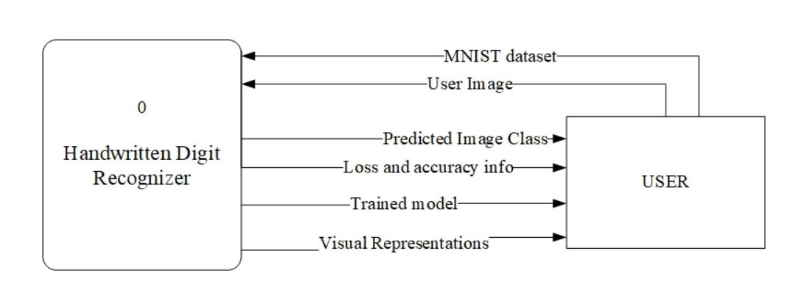
System Analysis
Process Modeling
Fig: Context Diagram
7

Slide 8
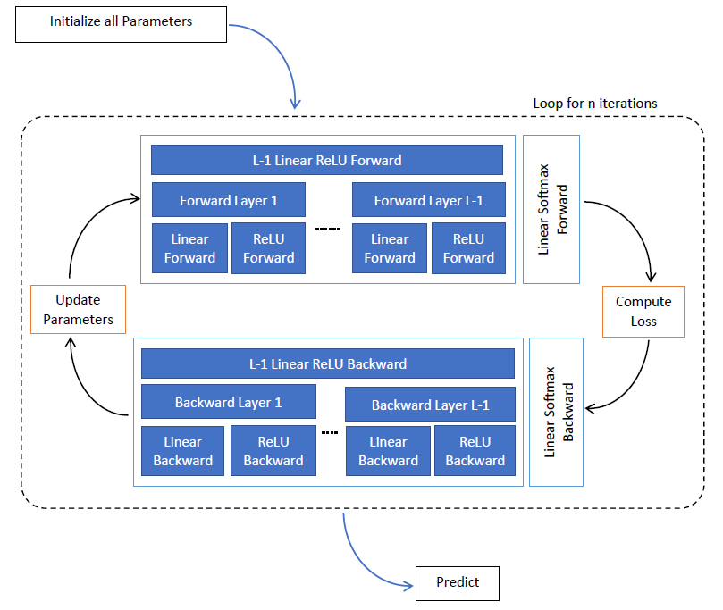
System Design
Base Model Architecture
Number of Layers: 3 ; 2 Hidden and 1 Output layers
Layer 1: 32 Hidden Units
Layer 2: 16 Hidden Units
Layer 3: 10 Units
Learning Rate: 0.1
Number of Epoch: 10000
Feedforward Neural Network Model
8

Slide 9
System Design
Base Model Architecture
Activation Functions: ReLU in Hidden Layers and Softmax in Output Layer
Cost Function: Softmax Cross Entropy Cost Function
Algorithm: Batch Gradient Descent with Back Propagation
Initialization: Random
Feedforward Neural Network Model
9

Slide 10
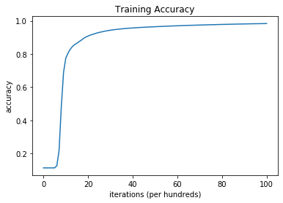
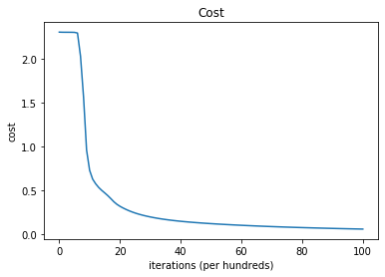
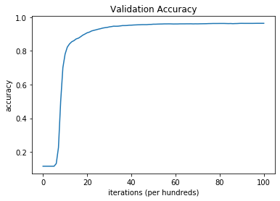
Visualization
Fig: Visualization of Cost and Accuracy during Training
10

Slide 11
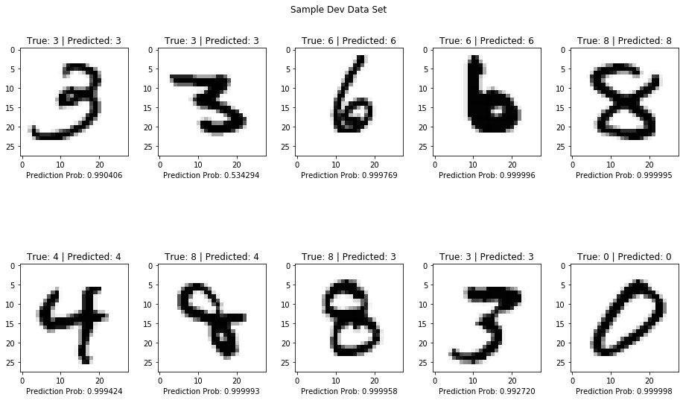
Visualization
Fig: Prediction of Dev Set Data
11

Slide 12
Output and Analysis
There seems a problem of high bias and high variance
To reduce high Bias:
Try advanced optimization algorithms
Train Larger Network
Tune Hyper Parameter
To reduce high variance:
Regularization should be carried out
Dataset | Accuracy | Error
Training Set | 98.39% | 1.61%
Dev Set | 96.32% | 3.680%
Test Set | 96.68% | 3.32%
12

Slide 13
Conclusion and Further Work
Algorithms like Mini-batch Gradient Descent and Adam will be used
Regularization methods like Dropout and L2 regularization will be used
The model will be trained in larger Network
He- Initialization would be used to initialize the parameters
Tuning of Hyper Parameters would be done to obtain better result
13

